Slide 1


International Economics: Theory and Policy
Twelfth Edition
Chapter 4
Specific Factors and Income Distribution
Copyright © 2022, 2018, 2015 Pearson Education, Inc. All Rights Reserved
Notes:
If this PowerPoint presentation contains mathematical equations, you may need to check that your computer has the following installed:
1) MathType Plugin
2) Math Player (free versions available)
3) NVDA Reader (free versions available)

Slide 2
Learning Objectives
4.1 Understand how a mobile factor will respond to price changes by moving across sectors.
4.2 Explain why trade will generate both winners and losers in the short run.
4.3 Understand the meaning of gains from trade when there are losers.
4.4 Discuss the reasons why trade is a politically contentious issue.
4.5 Explain the arguments in favor of free trade despite the existence of losers.

Slide 3
Preview
Introduction
The Specific Factors Model
International Trade in the Specific Factors Model
Income Distribution and the Gains from Trade
Politics of Trade Protection
International Labor Mobility
Summary

Slide 4
Introduction
If trade is so good for the economy, why is there such opposition?
Two main reasons why international trade has strong effects on the distribution of income within a country:
Resources cannot move immediately or costlessly from one industry to another.
Industries differ in the factors of production they demand.

Slide 5
The Specific Factors Model (1 of 4)
The specific factors model allows trade to affect income distribution.
Assumptions of the model:
Two goods, cloth and food.
Three factors of production: labor (L), capital (K), and land (T for terrain).
Perfect competition prevails in all markets.

Slide 6
The Specific Factors Model (2 of 4)
Cloth produced using capital and labor (but not land).
Food produced using land and labor (but not capital).
Labor is a mobile factor that can move between sectors.
Land and capital are both specific factors used only in the production of one good.

Slide 7
The Specific Factors Model (3 of 4)
How much of each good does the economy produce?
The production function for cloth gives the quantity of cloth that can be produced given any input of capital and labor:
is the output of cloth
K is the capital stock
is the labor force employed in cloth

Slide 8
The Specific Factors Model (4 of 4)
The production function for food gives the quantity of food that can be produced given any input of land and labor:
is the output of food
T is the supply of land
is the labor force employed in food

Slide 9
Production Possibilities (1 of 6)
How does the economy’s mix of output change as labor is shifted from one sector to the other?
When labor moves from food to cloth, food production falls while output of cloth rises.
Figure 4.1 illustrates the production function for cloth.

Slide 10
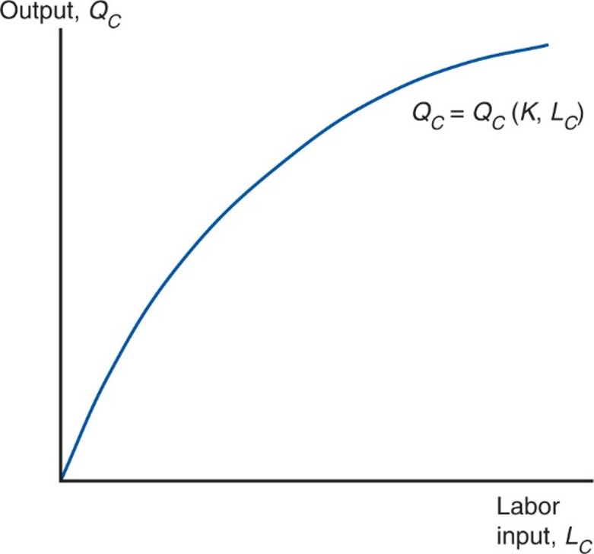
Figure 4.1 The Production Function for Cloth
The more labor employed in the production of cloth, the larger the output. As a result of diminishing returns, however, each successive person-hour increases output by less than the previous one; this is shown by the fact that the curve relating labor input to output gets flatter at higher levels of employment.

Slide 11
Production Possibilities (2 of 6)
The shape of the production function reflects the law of diminishing marginal returns.
Adding one worker to the production process (without increasing the amount of capital) means that each worker has less capital to work with.
Therefore, each additional unit of labor adds less output than the last.
Figure 4.2 shows the marginal product of labor, which is the increase in output that corresponds to an extra unit of labor.

Slide 12
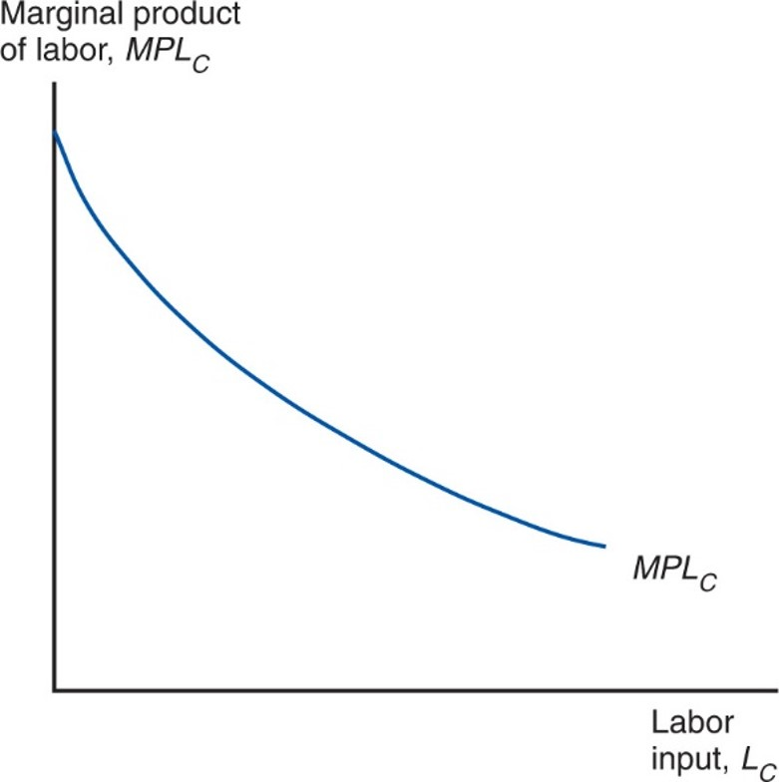
Figure 4.2 The Marginal Product of Labor
The marginal product of labor in the cloth sector, equal to the slope of the production function shown in Figure 4.1, is lower the more labor the sector employs.

Slide 13
Production Possibilities (3 of 6)
For the economy as a whole, the total labor employed in cloth and food must equal the total labor supply:
Use these equations to derive the production possibilities frontier of the economy.

Slide 14
Production Possibilities (4 of 6)
Use a four-quadrant diagram to construct production possibilities frontier in Figure 4.3.
Lower left quadrant indicates the allocation of labor.
Lower right quadrant shows the production function for cloth from Figure 4.1.
Upper left quadrant shows the corresponding production function for food.
Upper right quadrant indicates the combinations of cloth and food that can be produced.

Slide 15
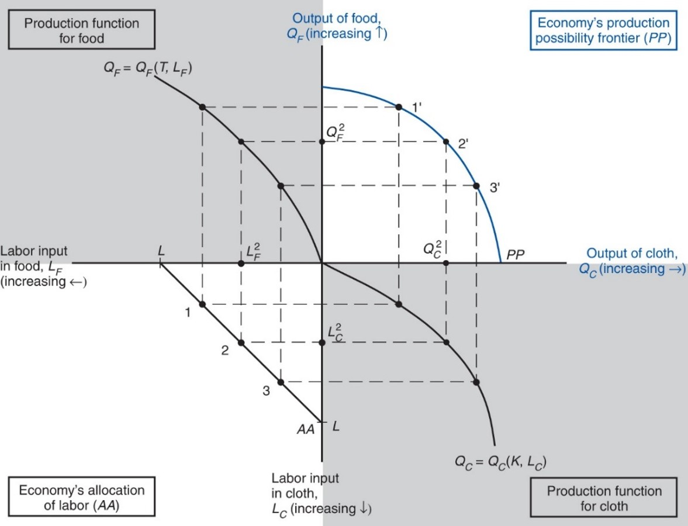
Figure 4.3 The Production Possibility Frontier in the Specific Factors Model
P P in the upper-right quadrant shows the economy’s production possibilities for given supplies of land, labor, and capital. Due to diminishing returns, P P is a bowed-out curve instead of a straight line.
Notes:
The origin of the graph is the intersection of the labor input in food and the output of cloth, on the x-axis, versus the output of food down to the labor input in cloth, on the y-axis. The upper left quadrant is production function of food, Q sub F = Q sub F (T, L sub F). The y-axis is the output of food, Q sub F, which increases upward from the origin, versus the labor input of food, L sub F, which increases leftward from the origin. The plot rises to the left with decreasing steepness from the origin through 3 points. The upper right quadrant is the economy’s production possibility frontier, P P; the y-axis is output of food, Q sub F, which increase upward from the origin, and the x-axis is output of cloth, Q sub C, which increases rightward from the origin. The plot falls with increasing steepness from the y-axis to the x-axis through 3 points, 1 prime, 2 prime, and 3 prime. The lower left quadrant is the economy’s allocation of labor, A A. It has an upper x-axis of labor input of food, L sub F, which increases leftward from the origin, and a y-axis at the right for labor input in cloth, L sub C., which increases downward from the origin. The plot is a straight line that extends downward from point L on the x-axis to point L on the y-axis, through points 1, 2, and 3. The lower right quadrant is the production function for cloth, Q sub C = Q sub C, left parenthesis K comma L sub C right parenthesis. The quadrant has an upper x-axis of output of cloth, Q sub C, which increases rightward from the origin, and a y-axis at the left for labor input in cloth, L sub C, which increases downward from the origin. The plot falls from the origin with increasing steepness through 3 points. Additional points are placed on each axis as follows: L squared sub F, on the axis for L sub F where A A = 2; Q squared sub F, on the Q sub F axis where P P = 2 prime; Q squared sub C, on the Q sub C axis where P P = 2 prime; and L squared sub C, on the L sub C axis where A A = 2.

Slide 16
Production Possibilities (5 of 6)
Why is the production possibilities frontier curved?
Diminishing returns to labor in each sector cause the opportunity cost to rise when an economy produces more of a good.
Opportunity cost of cloth in terms of food is the slope of the production possibilities frontier—the slope becomes steeper as an economy produces more cloth.

Slide 17
Production Possibilities (6 of 6)
Opportunity cost of producing one more yard of cloth is
pounds of food.
To produce one more yard of cloth, you need
hours of labor.
To free up one hour of labor, you must reduce output of food by
pounds.
To produce less food and more cloth, employ less in food and more in cloth.
The marginal product of labor in food rises and the marginal product of
labor in cloth falls, so
rises.

Slide 18
Prices, Wages, and Labor Allocation (1 of 10)
How much labor is employed in each sector?
Need to look at supply and demand in the labor market.
Demand for labor:
In each sector, employers will maximize profits by demanding labor up to the point where the value produced by an additional hour equals the marginal cost of employing a worker for that hour.

Slide 19
Prices, Wages, and Labor Allocation (2 of 10)
The demand curve for labor in the cloth sector:
The wage equals the value of the marginal product of labor in manufacturing.
The demand curve for labor in the food sector:
The wage equals the value of the marginal product of labor in food.

Slide 20
Prices, Wages, and Labor Allocation (3 of 10)
Figure 4.4 represents labor demand in the two sectors.
The demand for labor in the cloth sector is
from Figure 4.2 multiplied by
The demand for labor in the food sector is measured from the right.
The horizontal axis represents the total labor supply L.

Slide 21
Prices, Wages, and Labor Allocation (4 of 10)
The two sectors must pay the same wage because labor can move between sectors.
If the wage were higher in the cloth sector, workers would move from making food to making cloth until the wages become equal.
Or if the wage were higher in the food sector, workers would move in the other direction.
Where the labor demand curves intersect gives the equilibrium wage and allocation of labor between the two sectors.

Slide 22
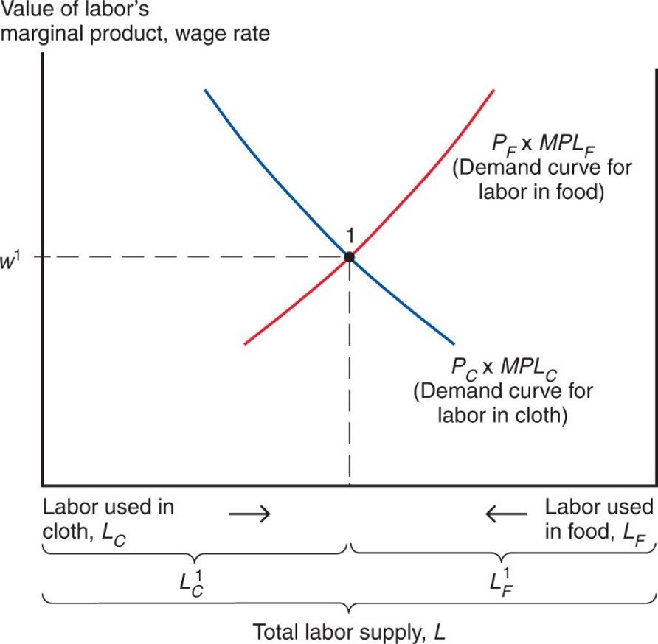
Figure 4.4 The Allocation of Labor
Labor is allocated so that the value of its marginal product
is the same in the cloth and food sectors. In equilibrium, the wage rate is equal to the value of labor’s marginal product.
Notes:
The total labor supply is divided into two equal parts, labor used in cloth or L sub C, and labor used in food or L sub F. These parts are labeled L super 1 sub C, on the left, and L super 1 sub F, on the right, and decrease toward the center of the x-axis, increasing outward in opposite directions. The demand curve for labor in cloth, P sub C times M P L sub C, falls with decreasing steepness from left to right. The demand curve for labor in food, P sub F times M P L sub F, rises with increasing steepness from left to right. The two curves intersect at point 1, where y = w super 1, and the labor used in cloth is equal to the labor used in food.

Slide 23
Prices, Wages, and Labor Allocation (5 of 10)
At the production point, the production possibility frontier must be tangent to a line whose slope is minus the price of cloth divided by that of food.
Relationship between relative prices and output:

Slide 24
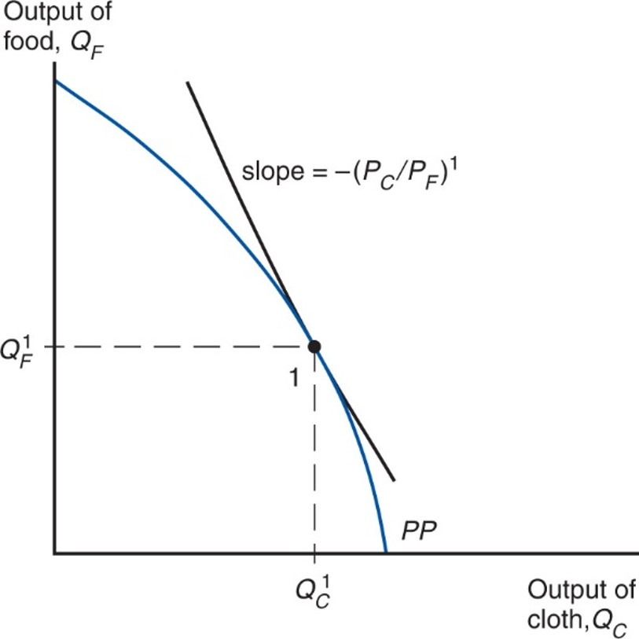
Figure 4.5 Production in the Specific Factors Model
The economy produces at the point on its production possibility frontier (P P) where the slope of that frontier equals minus the relative price of cloth.
Notes:
The plot falls with increasing steepness from y-axis to x-axis. The slope = negative, left parenthesis, P sub C, over P sub F, right parenthesis, super 1, where y = Q super 1 sub F and x = Q super 1 sub F, which intersect at point 1 on the curve.

Slide 25
Prices, Wages, and Labor Allocation (6 of 10)
What happens to the allocation of labor and the distribution of income when the prices of food and cloth change?
Two cases:
An equal proportional change in prices
A change in relative prices

Slide 26
Prices, Wages, and Labor Allocation (7 of 10)
When both prices change in the same proportion, no real changes occur.
The wage rate (w) rises in the same proportion as the prices, so real wages (i.e., the ratios of the wage rate to the prices of goods) are unaffected.
The real incomes of capital owners and landowners also remain the same.

Slide 27
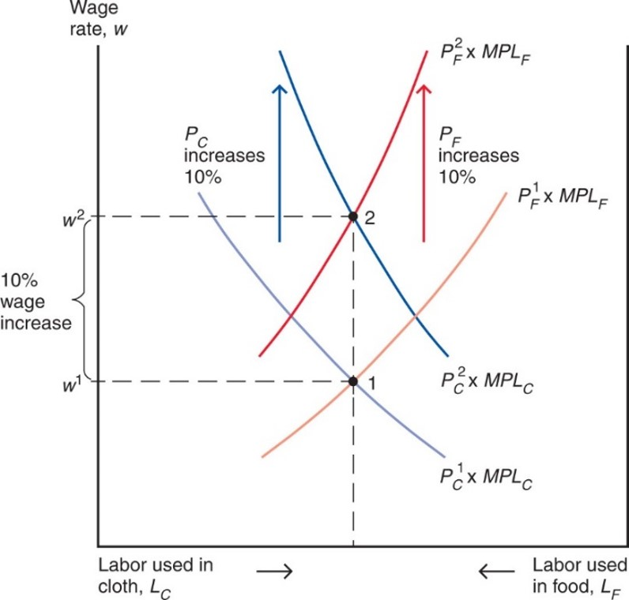
Figure 4.6 An Equal-Proportional Increase in the Prices of Cloth and Food
The labor demand curves in cloth and food both shift up in proportion to
the rise in
and the rise in
The wage rate rises in the same proportion, from
but the allocation of labor between the two sectors does not change.
Notes:
The graph shows wage rate versus labor supply, which is divided into 2 equal parts, labor used in cloth or L sub C, and labor used in food or L sub F. Labor used in cloth increases to the left and labor used in food increases to the right. The plot for P sub C super 1 times M P L sub C falls with decreasing steepness from left to right. The plot for P sub F super 1 times M P L sub F rises from left to right with increasing steepness. The two plots intersect at point 1, where y = w 1. With a 10% wage increase to y = W super 2, both the P sub C and P sub F increase by 10%; the plots also rise or fall with greater steepness. The plot for P sub C super 2 times M P L sub C falls from left to right with decreasing steepness, and the plot for P sub F super 2 times M P L sub F rises with increasing steepness. The plots intersect at point 2, where y = w super 2, at the same x-value as point 1.

Slide 28
Prices, Wages, and Labor Allocation (8 of 10)
When only
rises, labor shifts from the food sector
to the cloth sector and the output of cloth rises while that of food falls.
The wage rate (w) does not rise as much as
since
cloth employment increases and thus the marginal product of labor in that sector falls.

Slide 29
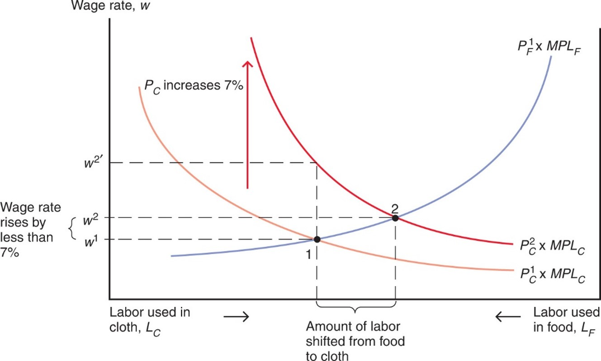
Figure 4.7 A Rise in the Price of Cloth
The cloth labor demand curve rises in proportion to the 7 percent
increase in
but the wage rate rises less than proportionately.
Labor moves from the food sector to the cloth sector. Output of cloth rises; output of food falls.
Notes:
Labor used in cloth increases to the left and labor used in food increases to the right. Horizontal lines are drawn at y = w super 1, and y = w super 2, which indicated a wage rate rise by less than 7%. A dotted line at y = w super 2 prime indicates is above y = W super 2. The plot for P sub F super 1 times M P L sub F rises with increasing steepness through point 1, where y = w super 1, and through point 2, where y = w super 2. The plot for P sub C super 1 times M P L sub C falls with decreasing steepness through point 1, where y = w 1. With a P sub C increase of 7%, the plot for P sub C super 2 times M P L sub C falls with decreasing steepness through point 2, where y = w super 2. The dotted line for y = w super 2 intersected this plot in line with point 1 on the x-axis. Point 2 is shifted to the right of point 1.

Slide 30
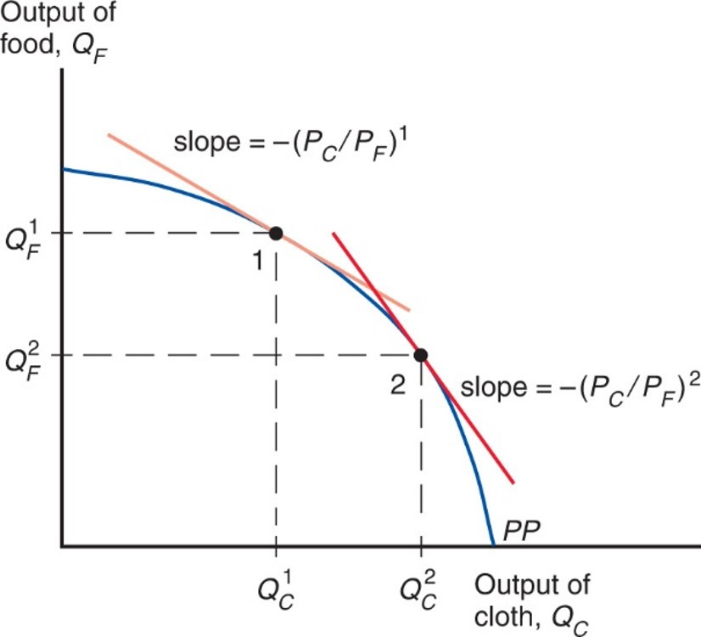
Figure 4.8 The Response of Output to a Change in the Relative Price of Cloth
The economy always produces at the point on its production possibility frontier (P P) where the slope of P P equals minus the relative price of
cloth. Thus, an increase in
causes production to move down
and to the right along the production possibility frontier corresponding to higher output of cloth and lower output of food.
Notes:
The plot for P P falls with increasing steepness from the y-axis to the x-axis, through points 1 and 2. At point 1, where y = Q sub F super 1 and x = Q sub C super 1, the plot = negative, left parenthesis, P sub C over P sub F, right parenthesis, super 1. At point 2, where y = Q sub F super 2 and x = Q sub C super 2, the slope is more steep, labeled as negative, left parenthesis, P sub C over P sub F, right parenthesis, super 2.

Slide 31
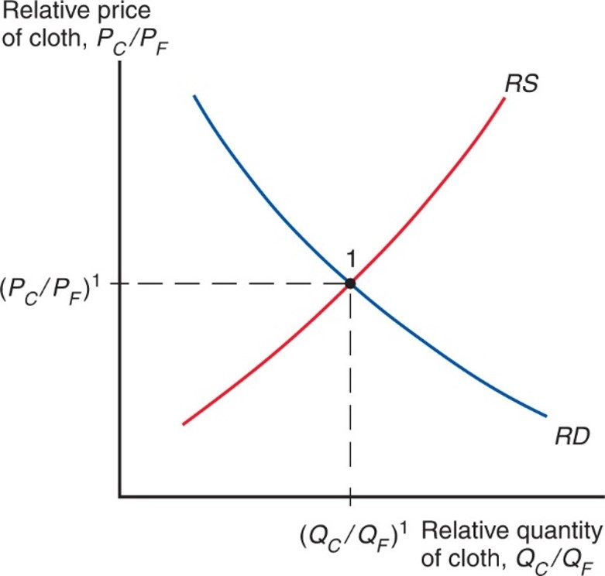
Figure 4.9 Determination of Relative Prices
In the specific factors model, a higher relative price of cloth will lead to an increase in the output of cloth relative to that of food. Thus, the relative supply curve R S is upward sloping. Equilibrium relative quantities and prices are determined by the intersection of R S with the relative demand curve R D.
Notes:
The R S curve rises with increasing steepness and intersects the R D curve, which falls with decreasing steepness. Their intersection is the equilibrium, point 1. At point 1, y = P sub C over P sub F, super 1, and x = Q sub C over Q sub F, super 1.

Slide 32
Prices, Wages, and Labor Allocation (9 of 10)
Relative Prices and the Distribution of Income
Suppose that
increases by 10%. Then, the
wage would rise by less than 10%.
What is the economic effect of this price increase on the incomes of the following three groups?
Workers, owners of capital, and owners of land

Slide 33
Prices, Wages, and Labor Allocation (10 of 10)
Owners of capital are definitely better off.
Landowners are definitely worse off.
Workers: cannot say whether workers are better or worse off:
Depends on the relative importance of cloth and food in workers’ consumption.

Slide 34
International Trade in the Specific Factors Model (1 of 3)
Trade and Relative Prices
The relative price of cloth prior to trade is determined by the intersection of the economy’s relative supply of cloth and its relative demand.
Free trade relative price of cloth is determined by the intersection of world relative supply of cloth and world relative demand.
Opening up to trade increases the relative price of cloth in an economy whose relative supply of cloth is larger than for the world as a whole.

Slide 35
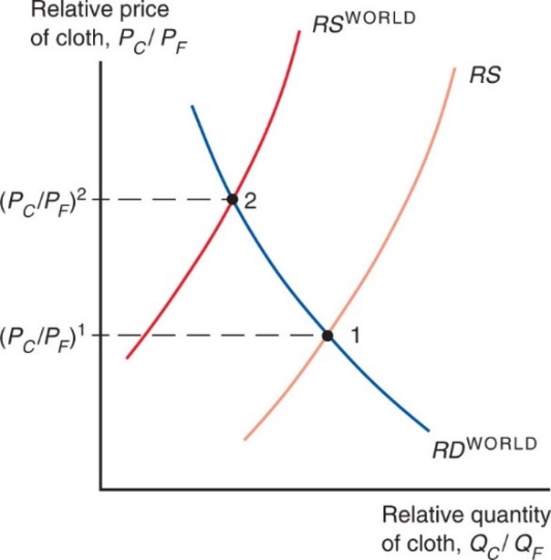
Figure 4.10 Trade and Relative Prices
The figure shows the relative supply curve for the specific factors economy along with the world relative supply curve. The differences between the two relative supply curves can be due to either technology or resource differences across countries. There are no differences in relative demand across countries. Opening up to trade induces an
increase in the relative price from
Notes:
2 R S curves, R S and R S super world, rise with increasing steepness. One R D curve for the world falls with decreasing steepness. The plot for R S world intersects R D super world at point 2, where y = P sub C over P sub F, super 2. This intersection is to the left of the intersection of R S and R D super world, which occurs at point 1, where y = P sub C over P sub F, super 1.

Slide 36
International Trade in the Specific Factors Model (2 of 3)
Gains from trade
Without trade, the economy’s output of a good must equal its consumption.
International trade allows the mix of cloth and food consumed to differ from the mix produced.
The country cannot spend more than it earns:

Slide 37
International Trade in the Specific Factors Model (3 of 3)
The economy as a whole gains from trade.
It imports an amount of food equal to the relative price of cloth times the amount of cloth exported:
It is able to afford amounts of cloth and food that the country is not able to produce itself.
The budget constraint with trade lies above the production possibilities frontier in Figure 4.11.

Slide 38
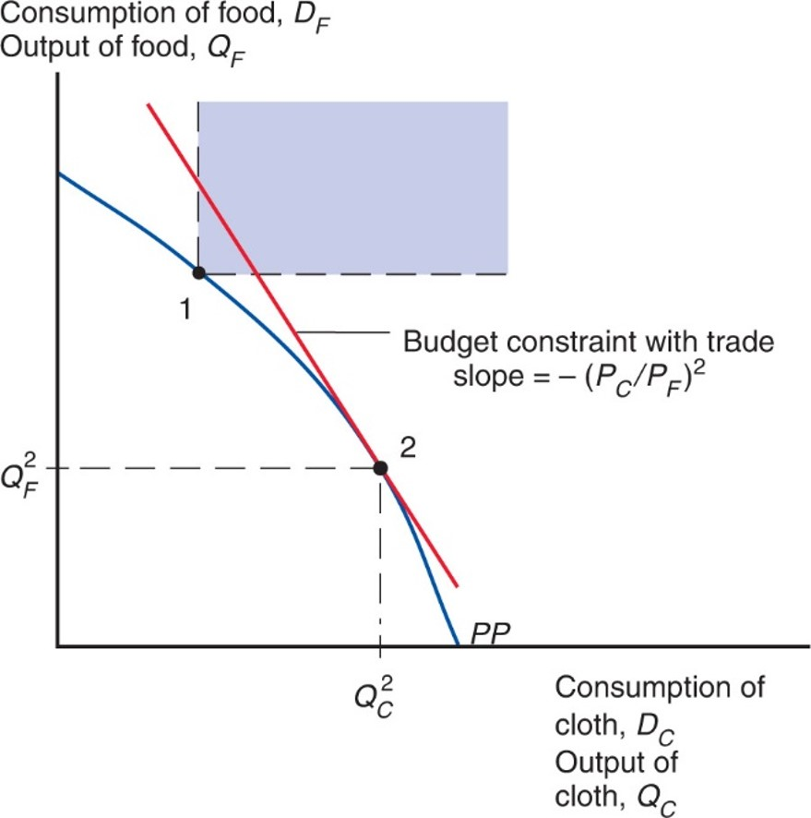
Figure 4.11 Budget Constraint for a Trading Economy and Gains from Trade
Point 2 represents the economy’s production. The economy can choose its consumption point along its budget constraint (a line that passes through point 2 and has a slope equal to minus the relative price of cloth). Before trade, the economy must consume what it produces, such as point 1 on the production possibility frontier (P P). The portion of the budget constraint in the colored region consists of feasible post-trade consumption choices, with consumption of both goods higher than at pretrade point 1.
Notes:
The plot for P P falls with increasing steepness from y-axis to x-axis, through points 1 and 2. Point 1 is higher on the plot, and forms the lower left vertex of the colored rectangular region. Point 2 is lower, where y = Q sub F super 1 and x = Q sub C super 1. The slope at point 2 indicates budget constraint with trade slope, = negative P sub C over P sub F, super 2.

Slide 39
Politics of Trade Protection (1 of 4)
International trade shifts the relative price of cloth to food, so factor prices change.
Trade benefits the factor that is specific to the export sector of each country, but hurts the factor that is specific to the import-competing sectors.
Trade has ambiguous effects on mobile factors.

Slide 40
Politics of Trade Protection (2 of 4)
Trade benefits a country by expanding choices.
Possible to redistribute income so that everyone gains from trade.
Those who gain from trade could compensate those who lose and still be better off themselves.
That everyone could gain from trade does not mean that they actually do—redistribution usually hard to implement.

Slide 41
Politics of Trade Protection (3 of 4)
Trade often produces losers as well as winners.
Optimal trade policy must weigh one group’s gain against another’s loss.
Some groups may need special treatment because they are already relatively poor (e.g., shoe and garment workers in the United States).
Most economists strongly favor free trade.

Slide 42
Politics of Trade Protection (4 of 4)
Typically, those who gain from trade are a much less concentrated, informed, and organized group than those who lose.
Example: Consumers and producers in the U.S. sugar industry, respectively
Governments usually provide a “safety net” of income support to cushion the losses to groups hurt by trade (or other changes).

Slide 43
Trade and Unemployment (1 of 3)
Trade shifts jobs from import-competing to export sector.
Process not instantaneous—some workers will be unemployed as they look for new jobs.
How much unemployment can be traced back to trade?
From 2001 to 2010, only about 2% of involuntary displacements stemmed from import competition or plants moved overseas.

Slide 44
Trade and Unemployment (2 of 3)
U.S. Trade Adjustment Assistance program provides extended unemployment coverage (for an additional year) and tuition reimbursement (for new job skill acquisitions) to workers who are displaced by a plant closure.
To qualify, the plant closure must be due to import competition or an overseas relocation to a country receiving preferential access to the United States.

Slide 45
Trade and Unemployment (3 of 3)
Figure 4.12 shows that there no evidence of a positive correlation between unemployment and imports (relative to U.S. G D P) for the United States.
After 2012, both imports and unemployment do drop significantly; However, the drop in imports was driven by falling oil prices. Non-oil imports as a share of U.S. G D P remained stable in those years.
Unemployment is primarily a macroeconomic problem that rises during recessions.
The best way to reduce unemployment is by adopting macroeconomic policies to help the economy recover, not by adopting trade protection.

Slide 46
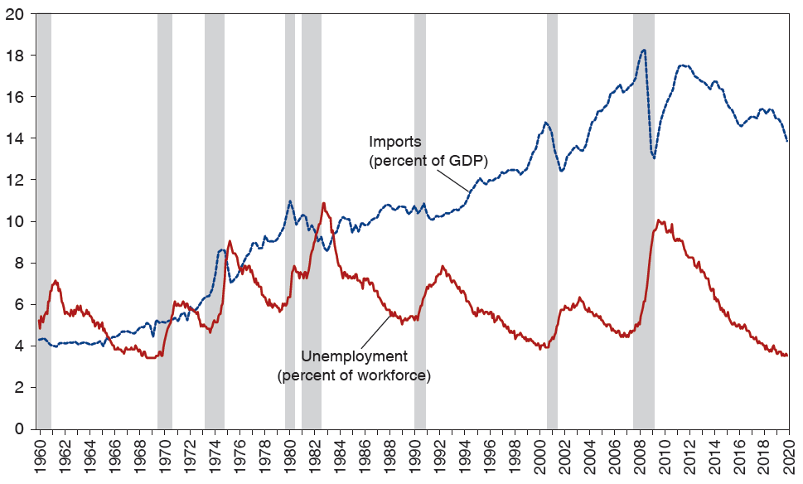
Figure 4.12 Unemployment and Import Penetration in the United States
The highlighted years are recession years, as determined by the National Bureau of Economic Research.
Source: U.S. Bureau of Economic Analysis for imports and U.S. Bureau of Labor Studies for unemployment.
Notes:
The graph depicts percentages for both imports as a percent of G D P and unemployment as a percent of the workforce, versus years 19 60 to 20 20. Recessions are highlighted, with corresponding spikes in unemployment and dips in imports. The plot for imports generally rises from (19 60, 4.3) through (19 90, 9.8) to (20 12, 17), and then falls to (20 20, 14). A significant dip occurs at (2009, 13). The plot for unemployment rises and falls inconsistently, through points (19 60, 5), (19 82, 11), (19 90, 5), (2009, 9), and (20 20, 3.5). The shaded areas for U S recessions, by years, are as follows. 19 60 to 19 61, 19 70, 19 73 to 19 75, 19 80, 19 81 to 19 83, 19 90 to 19 91, 2001, 2008 to 2009. All values are estimated.

Slide 47
Manufacturing Employment and Chinese Import Competition (1 of 2)
Is import competition from developing countries—especially from China—at fault for declines in manufacturing employment in the United States?
Would closing off the United States from trade with China increase the share of employment in U.S. manufacturing?
Some workers in sectors that compete with Chinese imports may lose their jobs and take time to find new jobs.
Meanwhile, jobs are opening up in the export sectors of the economy.
What is the net effect of increase import competition on manufacturing employment?

Slide 48
Manufacturing Employment and Chinese Import Competition (2 of 2)
Figure 4.13 shows that this manufacturing employment share has been steadily decreasing over the last half-century.
U.S. manufacturing was still producing the same quantity of goods, but was using fewer and fewer workers (due to increase productivity).
Estimate share of manufacturing employment using data from before China became a major source of U.S. imports.
Accurate fit to manufacturing employment now.
China appears to have little, if any, effect.

Slide 49
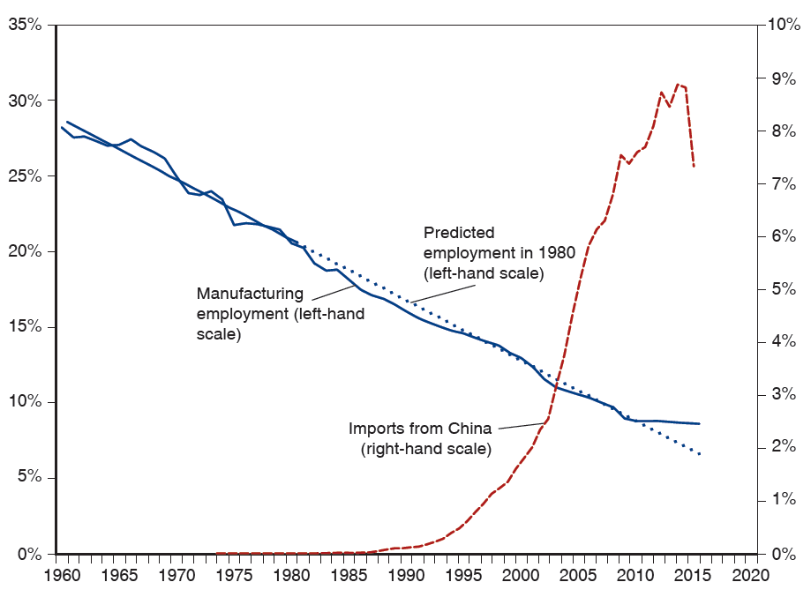
Figure 4.13 U.S. Manufacturing Employment and Imports from China
Manufacturing employment is measured as a percent of total U.S. non-farm employment. Imports from China are measured as a percent of the U.S. manufacturing production.
Notes:
The graph depicts percentages of U S manufacturing employment, versus years 19 60 to 20 20. Manufacturing employment fell from 28% in 19 60 to 10% in 20 20, and closely followed the predicted employment. Imports from China rose gradually from (19 72, 0.1%) to (19 85, 0.5%) and then rose steeply from (19 90, 0.25%) to (20 17, 7.5%). All values are estimated.

Slide 50
The Trump Trade War
Substantial political pressure to protect import-competing sectors, even if leads to aggregate losses.
Trade protection usually limited to a few hard-hit sectors.
The Trump administration enacted a vast set of tariffs on solar panels, washing machines, steel, aluminium, and an expanding list of manufactured good produced in China.
Many of the protected sectors contained a high proportion of intermediate goods imported by U.S. producers, harming jobs in these downstream sectors.
Retaliation by trading partners had a negative impact on employment by U.S. exporters.

Slide 51
International Labor Mobility (1 of 6)
Movements in factors of production include
Labor migration
The transfer of financial assets through international borrowing and lending
Transactions of multinational corporations involving direct ownership of foreign firms
Like movements of goods and services (trade), movements of factors of production are politically sensitive and are often restricted.

Slide 52
International Labor Mobility (2 of 6)
Why does labor migrate and what effects does labor migration cause?
Workers migrate to wherever wages are highest.
Consider movement of labor across countries instead of across sectors.
Suppose two countries produce one non-traded good (food) using two factors of production:
Land cannot move across countries but labor can.

Slide 53
International Labor Mobility (3 of 6)
Figure 4.13 finds the equilibrium wage and labor allocation with migration across countries.
Similar to how Figure 4.4 determined the equilibrium allocation of labor between sectors.
Start with
workers in Home earning a lower real wage
(point C) than the
workers in Foreign (point B).
Lower wage due to less land per worker (lower productivity).
Workers in the home country want to migrate to the foreign country where they can earn more.

Slide 54
International Labor Mobility (4 of 6)
If no obstacles to labor migration, workers move from Home to Foreign until the purchasing power of wages is equal across countries (point A),
with
workers in Home and
workers in Foreign.
Emigration from Home decreases the supply of labor and raises real wage of the workers who remain there.
Workers who start in the Home country earn more due to emigration regardless if they are among those who leave.
Immigration into Foreign increases the supply of labor and decreases the real wage there.
Wages do not actually equalize, due to barriers to migration such as policies restricting immigration and natural reluctance to move.

Slide 55
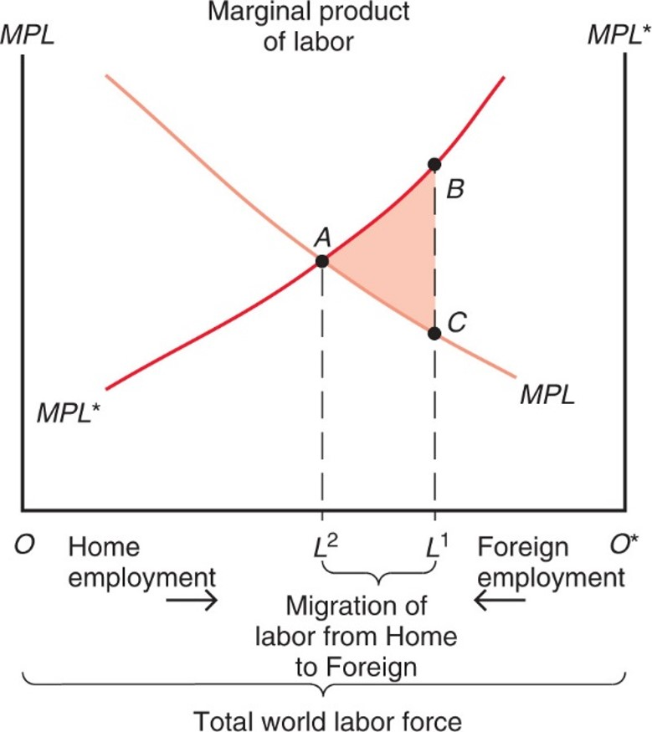
Figure 4.14 Causes and Effects of International Labor Mobility
Initially,
workers are employed in Home, while
workers are employed in Foreign. Labor migrates from Home to
Foreign until
workers are employed in Home,
in Foreign, and wages are equalized.
Notes:
versus total world labor force, which is split between home employment, O, on the left and foreign employment, O asterisk, on the right. The graph plots two curves, M P L for home labor, and M P L asterisk for foreign labor. The marginal product of home labor falls with decreasing steepness from left to right. The marginal product of foreign labor rises with increasing steepness from left to right. The plots intersect at point Ay, where x = L super 2. To the right of point Ay, rising on the M P L asterisk, is point B, where x = L super 1. Point C, falling on the M P L curve, is directly below point B, where x = L super 1. The triangular area between points Ay, B, and C is shaded and represents the migration of labor from home to foreign, the difference between L super 2 and L super 1.

Slide 56
International Labor Mobility (5 of 6)
Workers initially in Home benefit while workers in Foreign are hurt by inflows of other workers.
Landowners in Foreign gain from the inflow of workers decreasing real wages and increasing output.
Landowners in Home are hurt by the outflow of workers increasing real wages and decreasing output.

Slide 57
International Labor Mobility (6 of 6)
Due to higher wages in Western Europe relative to its new E U partners in Eastern Europe, there have been substantial east-to-west migration flows.
Has this process been associated with wage convergence as predicted by our model of labor mobility? Yes, it has.
Figure 4.15 plots the relative wage of manufacturing workers from the new 2004 member countries relative to Western Europe.
Large compensation differentials still persist, but the trend is toward convergence.

Slide 58
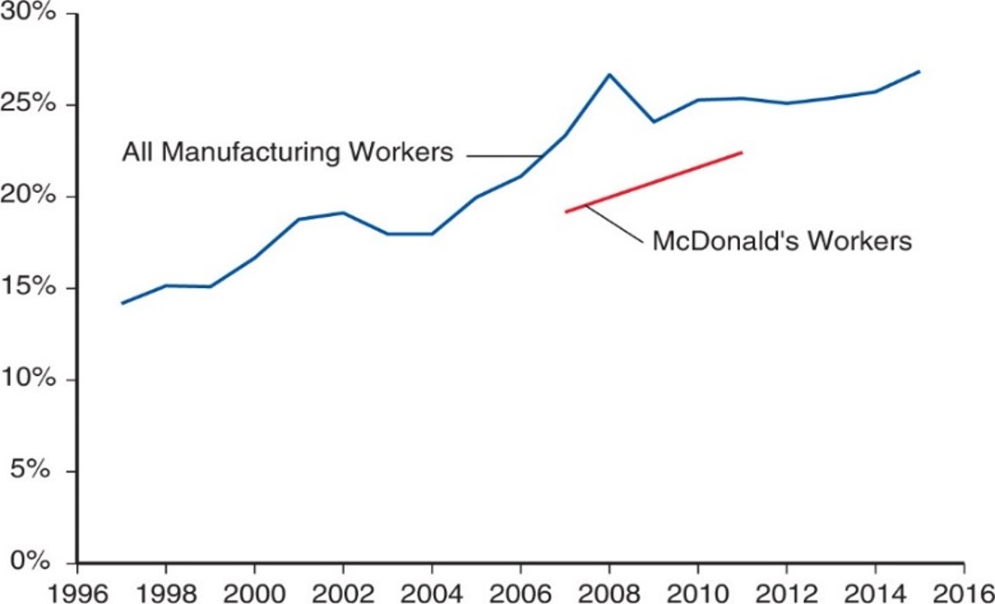
Figure 4.15 Eastern–Western Europe Relative Compensation 1997–2015
Western Europe includes: Austria, Belgium, Denmark, Finland, France, Germany, Greece, Ireland, Italy, Netherlands, Norway, Portugal, Spain, Sweden, Switzerland, and the United Kingdom. Eastern Europe includes: the Czech Republic, Estonia, Hungary, Poland, Slovakia.
Source: The Conference Board International Labor Comparisons, 2016; and Orley Ashenfelter and Stepan Jurajda, "Comparing Real Wage Rates using McWages", mimeo, 2020.
Notes:
The plot for all manufacturing workers rises from (1997, 14) through (2008, 27) to (2015, 27). Below it, the plot for McDonald’s is a straight line that rises from (2007, 18) to (2011, 22). All values estimated.

Slide 59
Immigration and the U.S. Economy (1 of 2)
In the early 20th century, share of immigrants in the United States increased dramatically.
Vast immigration from Eastern and Southern Europe.
Tight restrictions on immigration imposed in the 1920s.
Immigrants were a minor force in the United States by the 1960s.
New wave of immigration began around 1970.
Mostly from Latin America and Asia.
As of 2014, 16.7% of the U.S. labor force is foreign-born.

Slide 60
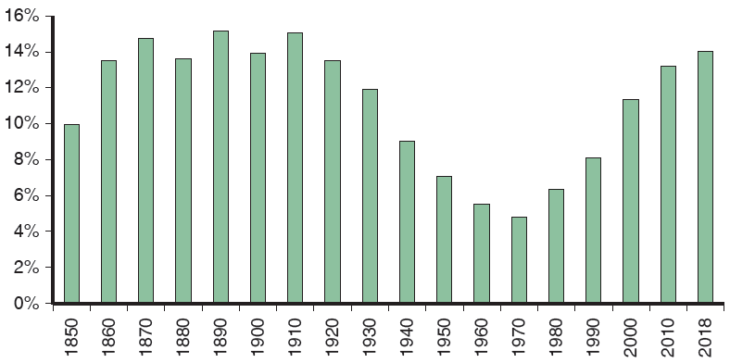
Figure 4.16 Foreign-Born Population as a Percentage of the U.S. Population
Restrictions on immigration in the 1920s led to a sharp decline in the foreign-born population in the mid-20th century, but immigration has risen sharply again in recent decades.
Source: U.S. Census Bureau.
Notes:
The bar graph depicts percentage of the foreign born population in the U S versus decades, 18 50 to 20 10, and 2018. From 18 50 to 19 10, the foreign born population as a percentage of the U S population generally grew from 10% to 14.5%. From 19 20 to 19 70 the percentage declined each decade from 13.5% to 5%. In 19 80, it started to rise again each decade, from 7% to 13% in 20 18. All values are estimated.

Slide 61
Immigration and the U.S. Economy (2 of 2)
The largest increase in recent immigration occurred among workers with the lowest education levels, making less educated workers more abundant.
Possibly reduced wages for native-born workers with low education levels while raising wages for the more educated
Widening wage gap between less educated workers and highly educated workers.

Slide 62
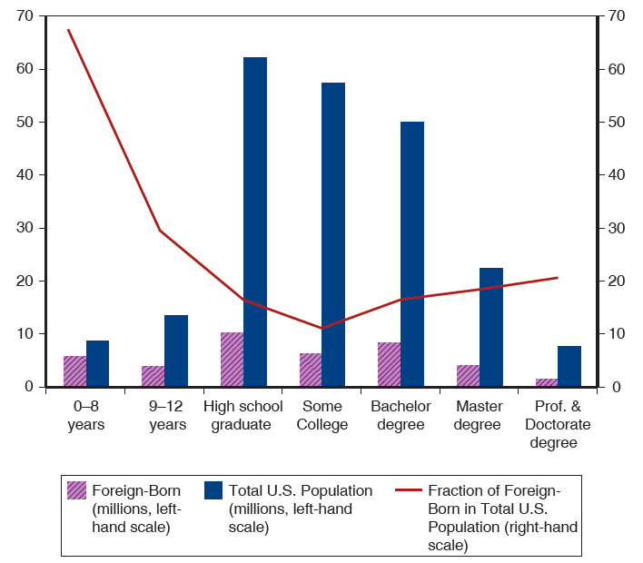
Figure 4.17 Foreign-Born and Total U.S. Population Over 25 Years Old by Educational Attainment
Relative to native-born workers, foreign-born workers are concentrated in both the highest and lowest educational groups.
Source: U.S. Census Bureau.
Notes:
The bar graph depicts foreign born and total U S population, in millions, by 7 levels of education, and is overlaid with a curve of the percentage of foreign born in the U S population. The following list provides number of workers, in millions, for foreign born then total U S population, by education level. 0 to 8 years, 6 million, 12 million. 9 to 12 years, 4 million, 16 million. High school graduate, 8 million, 64 million. 12 to 15 years, 5 million, 54 million. Bachelor degree, 8 million, 52 million. Master degree, 4 million, 22 million. Professional and doctorate degree, 1 million, 8 million. The plot for fraction of foreign born in the total U S population falls steeply from (0 to 8 years, 69%) to (9 to 12 years, 29%), then continues to fall through (high school graduate, 13%), and (Some college, 12%). The plot then rises through (bachelor degree, 18%), (master degree, 19%), and (professional and doctorate degrees, 22%). All values are estimated.

Slide 63
Summary (1 of 4)
International trade often has strong effects on the distribution of income within countries—produces losers as well as winners.
Income distribution effects arise for two reasons:
Factors of production cannot move costlessly and quickly from one industry to another.
Changes in an economy’s output mix have differential effects on the demand for different factors of production.

Slide 64
Summary (2 of 4)
International trade affects the distribution of income in the specific factors model.
Factors specific to export sectors in each country gain from trade, while factors specific to import-competing sectors lose.
Mobile factors that can work in either sector may either gain or lose.

Slide 65
Summary (3 of 4)
Trade nonetheless produces overall gains in the sense that those who gain could in principle compensate those who lose while still remaining better off than before.
Most economists would prefer to address the problem of income distribution directly, rather than by restricting trade.
Those hurt by trade are often better organized than those who gain, causing trade restrictions to be adopted.

Slide 66
Summary (4 of 4)
Labor migrates to countries with higher labor productivity and higher real wages, where labor is scarce.
Real wages fall due to immigration and rise due to emigration.
World output increases.
Real wages across countries are far from equal due to differences in technology and due to immigration barriers.

Slide 67
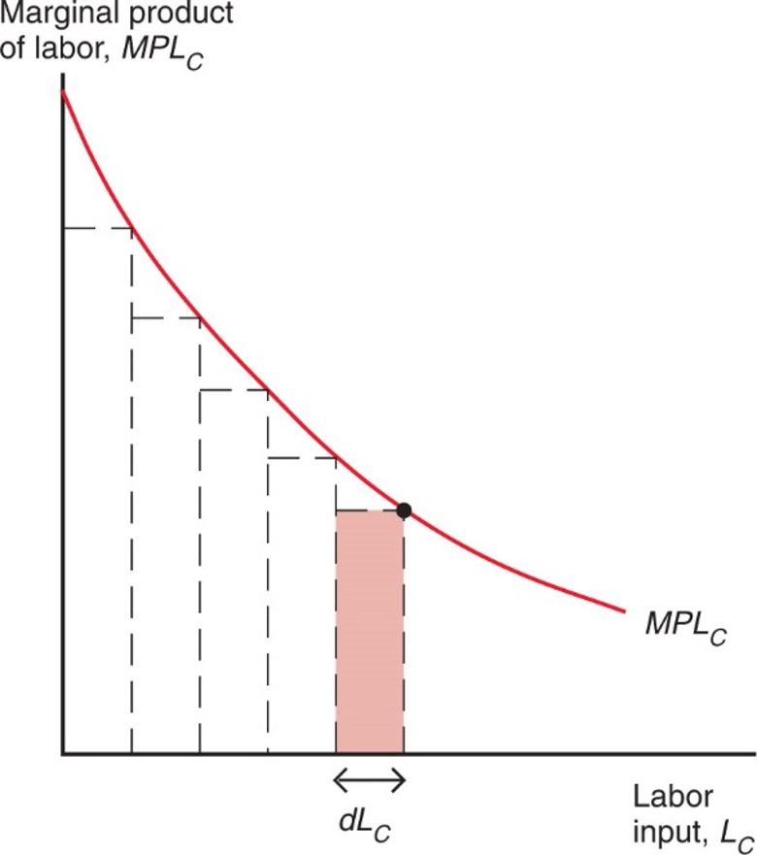
Figure 4A.1 Showing That Output Is Equal to the Area under the Marginal Product Curve
By approximating the marginal product curve with a series of thin rectangles, one can show that the total output of cloth is equal to the area under the curve.
Notes:
Under the curve are 5 rectangles formed by dotted lines, beginning at the y-axis, each the same width, d L sub C, along the x-axis. The upper right vertex of each rectangle is a point along the M P L sub C curve.

Slide 68
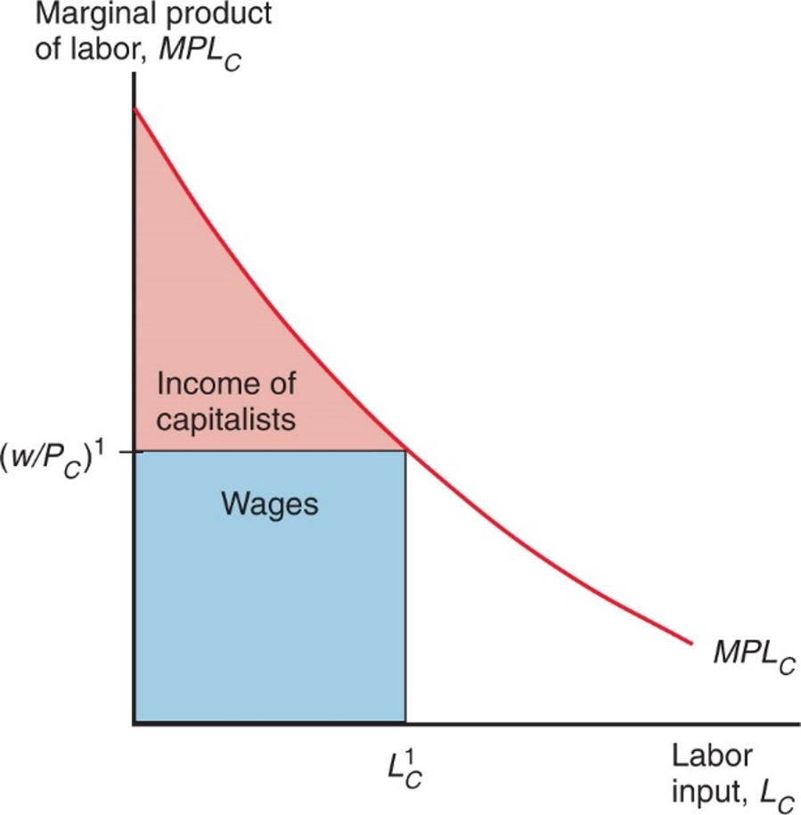
Figure 4A.2 The Distribution of Income within the Cloth Sector
Labor income is equal to the real wage times employment. The rest of output accrues as income to the owners of capital.
Notes:
The curve for M P L sub C falls with decreasing steepness from the y-axis. Roughly midway along the curve, a point forms the upper right vertex of a rectangle under the curve, where y = w over P sub C, super 1. The shaded rectangle, below this line, represents wages. A roughly triangular, shaded area above this line, between the y-axis and M P L sub C curve, represents the income of capitalists.

Slide 69
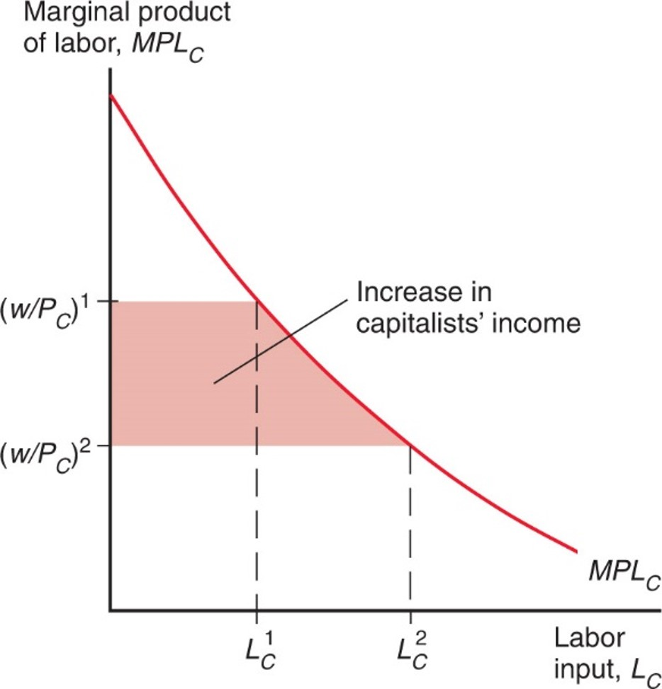
Figure 4A.3 A Rise in P Sub C Benefits the Owners of Capital
The real wage in terms of cloth falls, leading to a rise in the income of capital owners.
Notes:
The curve for M L P sub C falls with decreasing steepness from the y-axis. Dotted lines intersect the curve at x = L sub C super 1, and to the right at L sub C super 2. At x = L sub C super 1, y = w over P sub C, super 1; at x = L sub C super 2, y = w over P sub C, super 2. The area between the 2 intersections and the y-axis is shaded, and represents the increase in capitalists’ income.

Slide 70
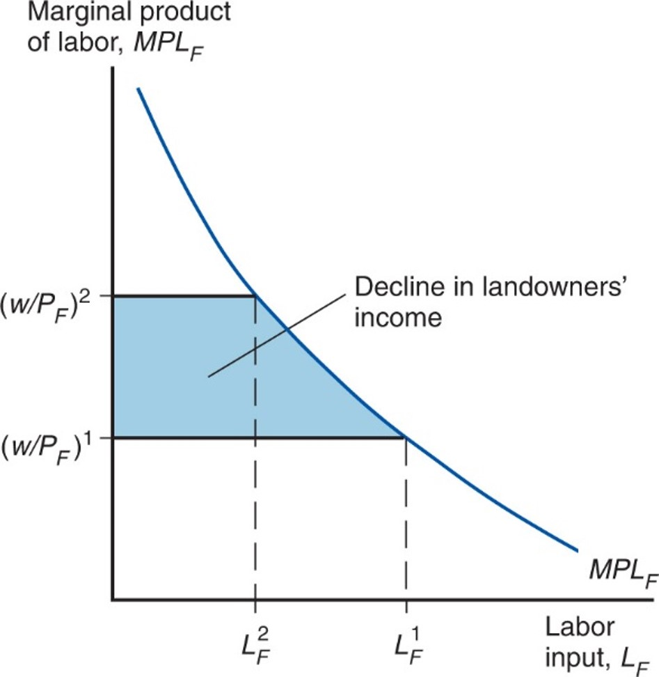
Figure 4A.4 A Rise in P Sub C Hurts Landowners
The real wage in terms of food rises, reducing the income of land.
Notes:
A plot for M P L sub F falls with decreasing steepness. Dotted lines intersect the curve at x = L sub F super 2, and to the right at L sub F super 1. At x = L sub F super 2, y = w over P sub F, super 2; at x = L sub F super 1, y = w over P sub F, super 1. The area between the 2 intersections and the y-axis is shaded, and represents the decline in landowners’ income.

Slide 71

Copyright
This work is protected by United States copyright laws and is provided solely for the use of instructors in teaching their courses and assessing student learning. Dissemination or sale of any part of this work (including on the World Wide Web) will destroy the integrity of the work and is not permitted. The work and materials from it should never be made available to students except by instructors using the accompanying text in their classes. All recipients of this work are expected to abide by these restrictions and to honor the intended pedagogical purposes and the needs of other instructors who rely on these materials.

